Slide 1



Using HQL
Chapter 14

Slide 2
Today’s Agenda
Using HQL-Part 1
What Is HQL ?
Why HQL ?
HQL V/s SQL
HQL Syntax
Executing SELCECT Queries
Selecting Full Object
Selecting Partial Object
Selecting Only One Column
Using As and Where
Exercises

Slide 3
What Is HQL ?
HQL is an abbreviation of Hibernate Query Language.
It is a powerful query language, inspired by SQL that the Hibernate uses.
It is as similar to SQL but with some important differences

Slide 4
Why HQL IS Needed ?
In our examples so far, we have executed CURD operations on a single object at a time.
Now , if we want to execute these operations on a group of objects then we can use one of the following techniques:
Hibernate Query Language (HQL)
Hibernate Criteria API
Native SQL

Slide 5
HQL V/s SQL
HQL is fully object-oriented.
It supports OOP concepts like inheritance, polymorphism, abstraction.

Slide 6
HQL V/s SQL
Queries in HQL are case-insensitive excluding the name of classes of Java and their properties.
For example in query WHerE is same as whERe but a class name Employee is not same as employee

Slide 7
Advantages Of HQL
Learning HQL is easy as it uses . operator which is used in Object-orientation.
Different SQL databases can be accessed by a single language

Slide 8
Advantages Of HQL
Using HQL , an SQL query is allowed to be represented as an object because in HQL rather than tables and columns we have classes and properties.
HQL returns its result as object and this feature of HQL reduces the process of creation of an object and population of data from ResultSet.

Slide 9
Advantages Of HQL
HQL provides database independent query writing.
HQL was initially given for selecting object from database but from hibernate 3.x DMLoperations ( insert, update…) too were allowed

Slide 10
Common HQL Commands
Some of the common HQL statements / clause are :
select
from
where
group by
order by
insert
update
delete

Slide 11
Executing HQL Commands
If we want to execute an HQL query on a database, we need to create a Query object
Query is an interface given in org.hibernate package
In order to get Query object, we call the createQuery() method in the session Interface

Slide 12
Executing HQL Commands
The createQuery() method returns an object of the class QueryImpl
The class QueryImpl is the implementation class of the Query interface.

Slide 13
Executing HQL Commands
Using Query object we call the list( ) method passing it the HQL query on database.
This method returns a java.util.List
Finally we use java.util.Iterator for iterating the List collection

Slide 14
The Select Statement
HQL provides us three types of select statements:
Those that select complete object
Those that select only partial object i.e. selected columns from the DB.
Those that select only one column from the table.

Slide 15
Selecting Complete Object
If we want to select a Complete Object from the database, we use POJO class reference in place of * while constructing the query:
In SQL
select * from employee;
In HQL
select e from Employee e;
OR
from Employee e

Slide 16
Selecting Partial Object
If we want to select a Partial Object from the database, that is only selective properties (selected columns) of objects then we need to replace column names with POJO class variable names.
In SQL
select empid,ename from employee;
In HQL
select e.empId,e.empName from EmployeeEx e;

Slide 17
Syntax For Selecting Complete Obj
Query qry = session.createQuery("--- HQL command ---");
List l = qry.list();
Iterator it = l.iterator();
while(it.hasNext())
{
Object o = it.next();
Employee e = (Employee)o;
----- ------- ---------
}

Slide 18
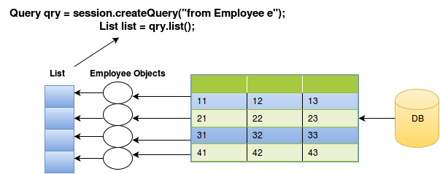
Syntax For Selecting Complete Obj

Slide 19
Syntax For Selecting Partial Obj
In this approach we can select selected columns , (selected columns, means more than one column not single column)
In this case , hibernate internally stores the multiple column values of each row into an object array and stores these object arrays into List collection
At the time of iterating the collection, we need to typecast the result into an object arrays

Slide 20
Syntax For Selecting Partial Obj
Query qry = session.createQuery("select e.empNum,e.empName
from EmployeeEx e");
List l =qry.list();
Iterator it = l.iterator();
while(it.hasNext())
{
Object o[ ] = (Object [])it.next();
System.out.println("-------");
----- ------- ------
}

Slide 21
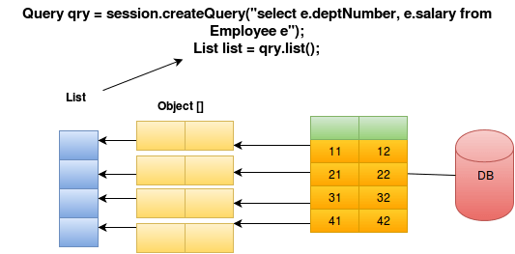
Syntax For Selecting Partial Obj

Slide 22
Syntax For Selecting Partial Obj With 1 Col
In this approach we select single column
In this case , hibernate internally creates an object of that value type and stores all these objects into the List collection
At the time of iterating the collection, we need to typecast into that object type only

Slide 23
Syntax For Selecting Partial Obj With 1 Col
Query qry = session.createQuery("select e.empNum, from
EmployeeEx e");
List l =qry.list();
Iterator it = l.iterator();
while(it.hasNext())
{
Integer i= (Integer)it.next();
System.out.println("-------");
----- ------- ------
}

Slide 24
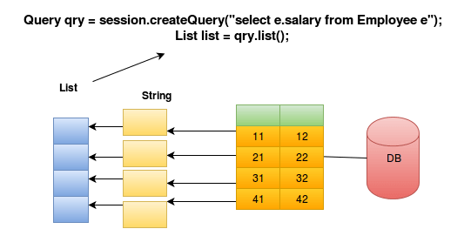
Syntax For Selecting Partial Obj With 1 Col

Slide 25
Using As
The AS clause can be used to assign aliases to the classes in our HQL queries, especially when we have the long queries.
For instance, our previous simple example could be rewritten as:
String hql = "FROM Employee As E";
Query query = session.createQuery(hql);
List results = query.list();

Slide 26
Using As
The AS keyword is optional and we can also specify the alias directly after the class name, as follows −
String hql = "FROM Employee E";
Query query = session.createQuery(hql);
List results = query.list();

Slide 27
Using Where
If we want to narrow the specific objects that are returned from database , then we use the WHERE clause.
Following is the simple syntax of using WHERE clause −
String hql = "FROM Employee E WHERE E.id = 10";
Query query = session.createQuery(hql);
List results = query.list();

Slide 28
Special Note
Note From Hibernate Docs:
Query is deprecated, and slated for removal in 6.0 so we must consider using hibernate.org.query.Query
For the time being we leave all methods defined on Query in hibernate.org.Query because it was previously the public API so we want to leave that unchanged in 5.x.
For 6.0 we will move those methods to hibernate.org.query.Query and then delete that class.

Slide 29
Exercise 1
Using HQL , write a program to fetch and display records of all the employees.
Solution:
Query obj=sess.createQuery("from Employee");
List ls=obj.list();
Iterator<Employee>it=ls.iterator();
while(it.hasNext())
{
Employee e=it.next();
System.out.println(e);
}

Slide 30
Exercise 2
Using HQL , write a program to fetch and display records of all the employees who earn more than 10000
Solution:
Query obj=sess.createQuery("from Employee E where E.empSal>10000");
List ls=obj.list();
Iterator<Employee>it=ls.iterator();
while(it.hasNext())
{
Employee e=it.next();
System.out.println(e);
}

